Slide 1
How do charities stop poverty?
To develop knowledge and understanding of the work of Christian Aid.
To develop knowledge and understanding of the work of Islamic Relief.
To evaluate the work of these two religious organisations.

Slide 2
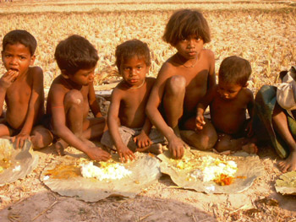
Look at the children above, then create a list of any problems that they are likely to face in their lives.

Slide 3
Voluntary Service
Many charities work in LEDCs in order to help reduce the effects of _______. Some work for little or no money by doing _________ service, especially if working overseas or for smaller charities in _______.
Each of the major religions has charities specifically set up to enable believers to _______ to need. Two of these specifically religious charities are Christian ___ and Islamic ______.
poverty voluntary Britain
respond Aid Relief

Slide 4
Voluntary Service
Many charities work in LEDCs in order to help reduce the effects of poverty. Some work for little or no money by doing voluntary service, especially if working overseas or for smaller charities in Britain.
Each of the major religions has charities specifically set up to enable believers to respond to need. Two of these specifically religious charities are Christian Aid and Islamic Relief.

Slide 5


Christian Aid and Islamic Relief
Whilst you watch the videos write down any points you get about work that the charity does.
You might choose to draw up a quick table.
Challenge: What are some of the similarities and/or differences between the two charities?

Slide 6


Religious Organisations
TASK: Collect an information sheet on one of the religious organisations. Then design an A4 poster to persuade people to support your chosen group.
You must include –
The charities logo
A slogan
Important information
Key religious teachings relating to the charity

Slide 7
Pen Pal
Think back to the starter image, then imagine that you are given the opportunity to write to this group to tell them all about your life, your experiences, the things you do on the weekends, your favourite drink/food.
Your task is to compose this letter, and then swap books with someone else so they can write a report on behalf of the child you have written to.

Slide 8
Plenary
‘We believe in life before death’.
Christian Aid uses the above phrase, what do you think it means?
How does it explain the work that they do?

